Slide 1

Congressional Staff Cybersecurity Training
March 24, 2025

Slide 2
Welcome
Who we are – American Governance Institute, R Street Institute, & Demand Progress Education Fund
Why we are holding this briefing – the threat to congressional staff in their personal capacities
Our focus – on your non-work devices

Slide 3
Scope
This isn't about policy.
We do not endorse a particular vendor.
Questions about official devices should be directed to the House CAO or Senate Sergeant at Arms.

Slide 4
District staff need special attention
Constituents may reach out through non-official channels.
Casework can trigger threats, such as from foreign states.
Distance from DC may limit awareness of support from DC-centric support offices and agencies.

Slide 5
Q & A
We will be taking your questions throughout. Please use the Q&A feature to ask your questions and we will answer at the end.

Slide 6
Agenda
Survey
Why you should care and HaveIBeenPwned.com
Passwords & Password Managers
Security: texting, mobile devices, and email
Multifactor authentication
Exit poll
Q & A

Slide 7
Audience Survey

Slide 8
Political & Government Staffers Are Top Targets
Trump presidential campaign infiltrated by foreign hackers via spear-phishing emails sent by fake US officials
Clinton presidential campaign infiltrated by foreign hackers via spear-phishing email sent by fake Google
“Salt Typhoon” reportedly hacked into phones of Trump & Vance and geolocation data of hundreds of phones throughout DC
DC Health Link data breach compromised personal data of Members of Congress, Hill staffers, and their families
OPM data breach compromised personal data of millions of current and former federal employees

Slide 9
Have you been pwned?
https://haveibeenpwned.com/

Slide 10
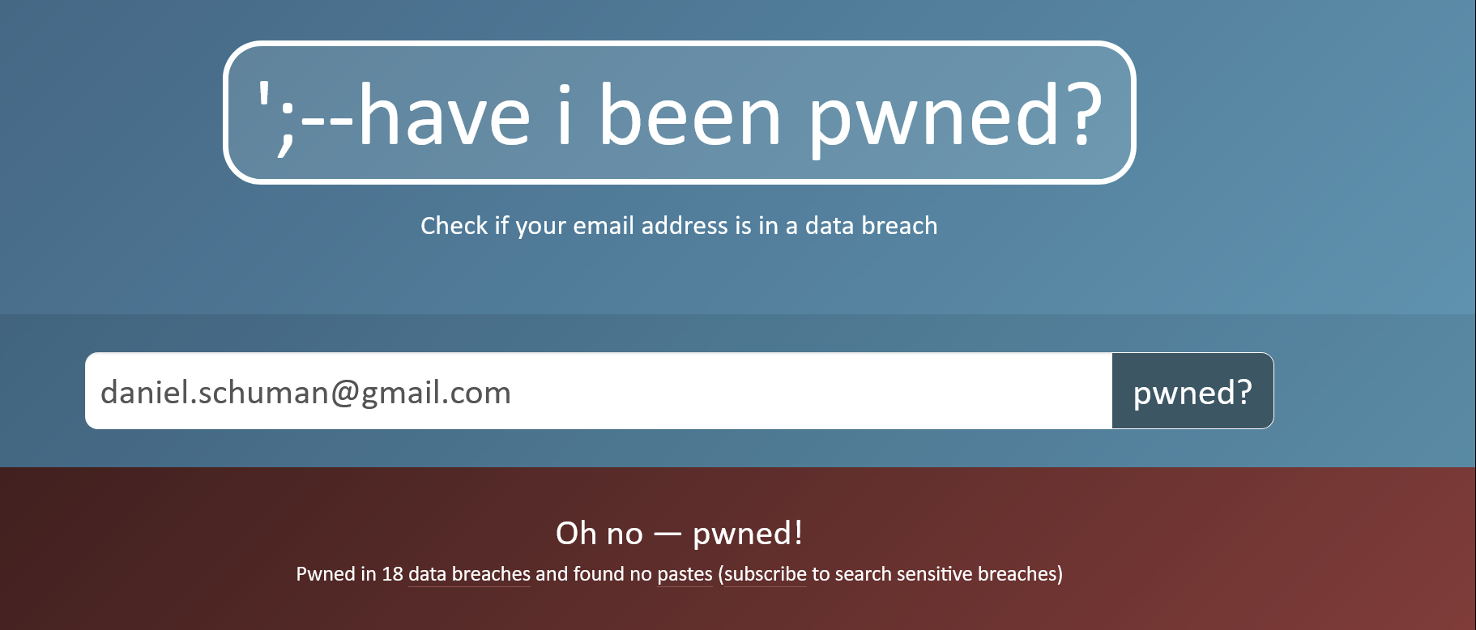
https://haveibeenpwned.com/

Slide 11
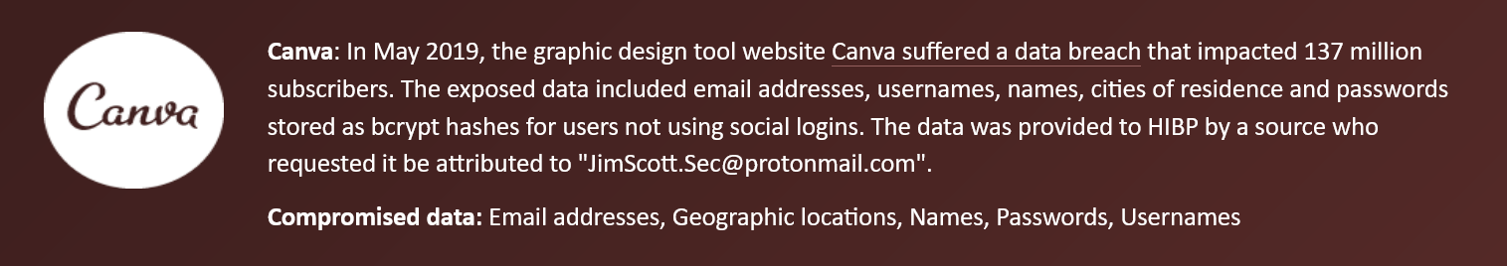
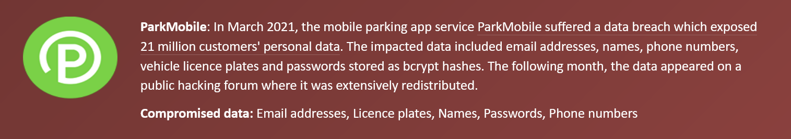
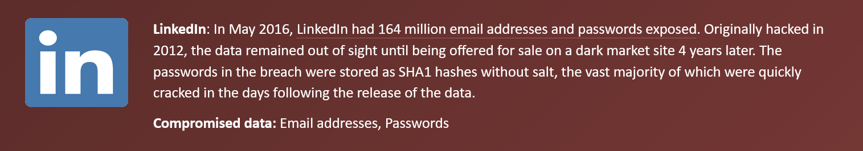
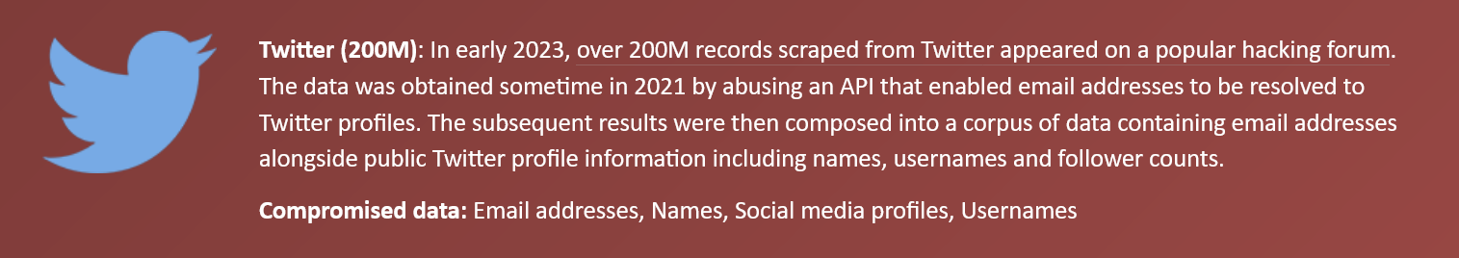
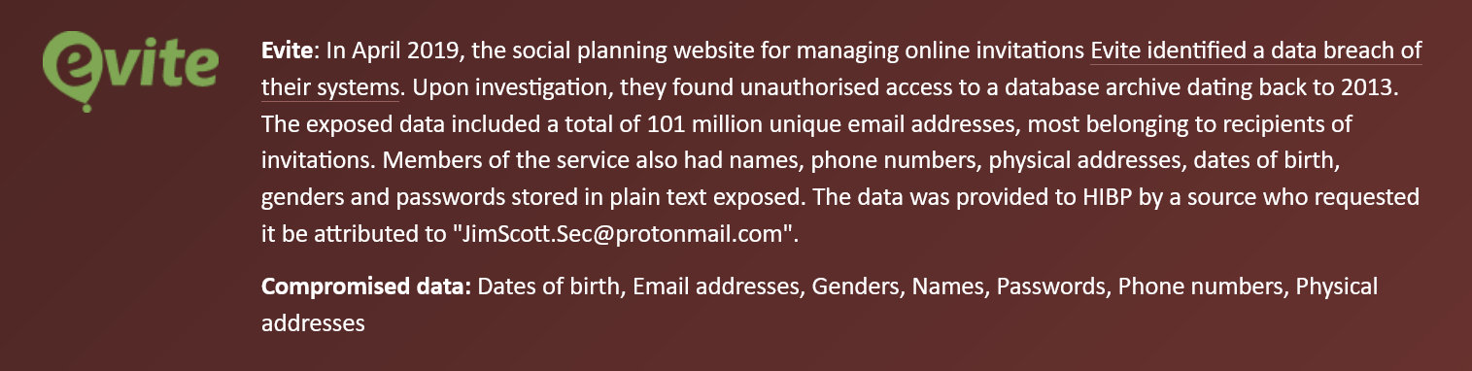
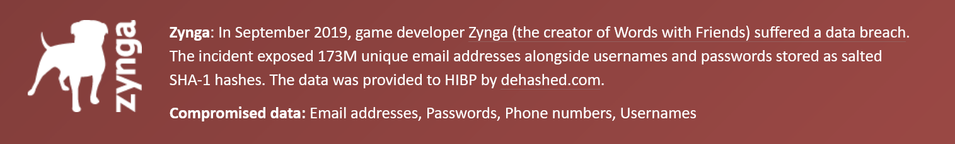
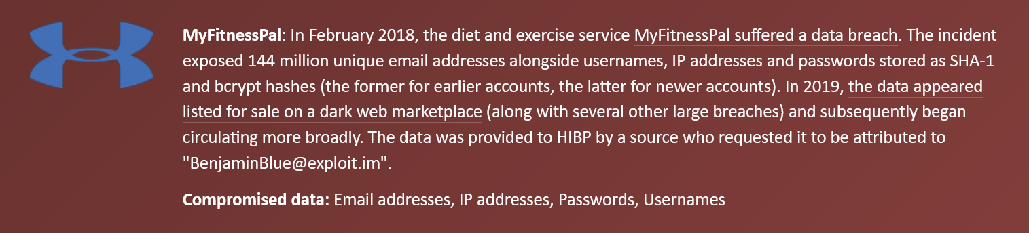

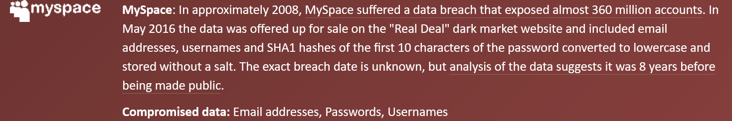

Slide 12
Passwords &
Password Managers
Daniel Schuman
American Governance Institute
Executive Director
Daniel@AmericaLabs.org
Notes:
Hello, there. 🖖

Slide 13
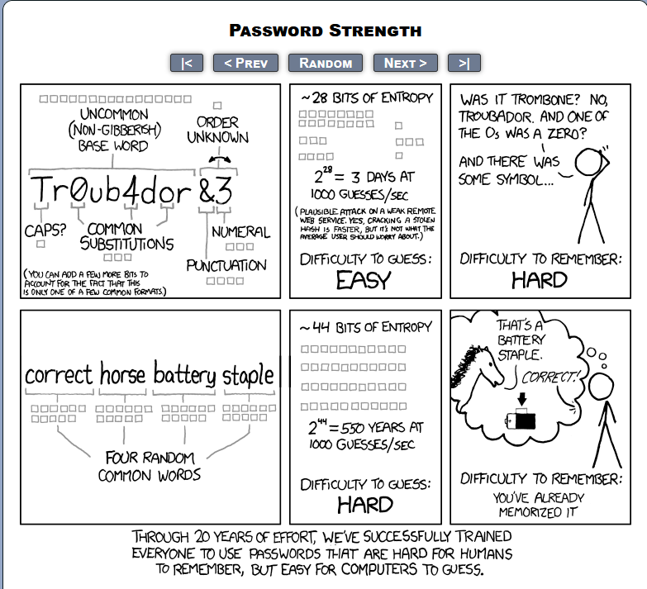
Notes:
The strongest passwords are longer. Passwords should be (1) hard to guess and (2) easy to remember (or track).

Slide 14
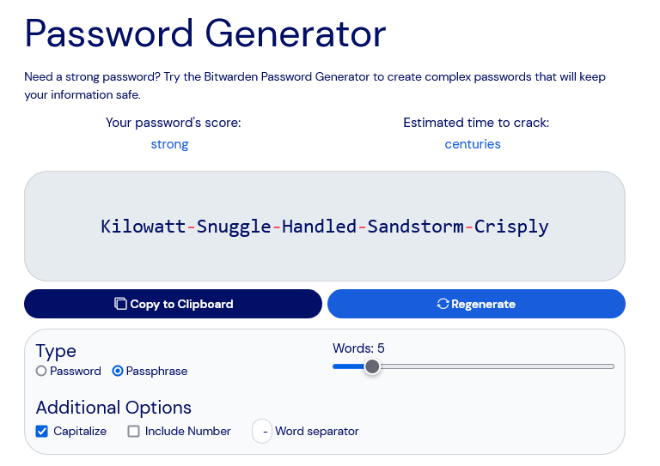
https://www.useapassphrase.com/
Notes:
You don’t need capitalization, numbers, special characters, but many password websites require them. You do need a longish unique random passphrase... and a way to keep track of it.

Slide 15


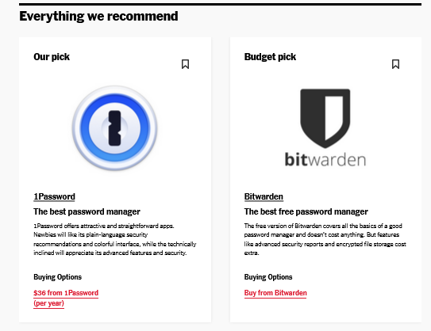
* The Senate uses Keeper for official use
https://www.nytimes.com/wirecutter/reviews/best-password-managers/
Notes:
Wirecutter recommends 1Password & BitWarden. Lots of others, but these are good. They solve the problem of remembering all your passwords so you only need to remember one. It can handle 2-factor.

Slide 16
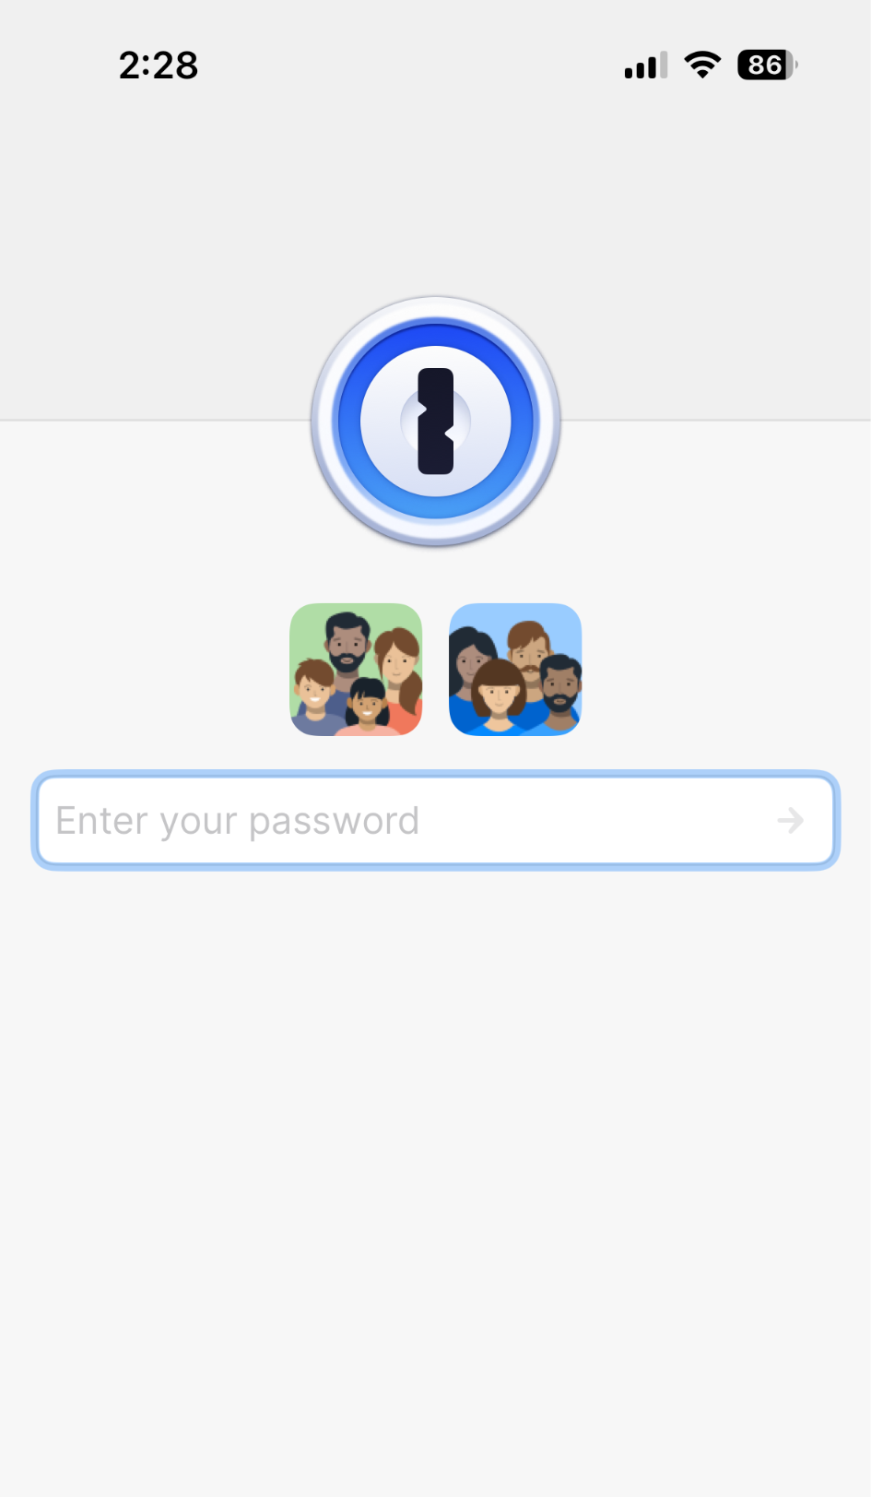
1Password
1 primary password
Syncs across all devices (mobile & desktop)
Autofills passwords
$2.99/month for individual account / $4.99/month family account
Notes:
Wirecutter recommends 1Password & BitWarden. Lots of others, but these are good. They solve the problem of remembering all your passwords so you only need to remember one. It can handle 2-factor.

Slide 17
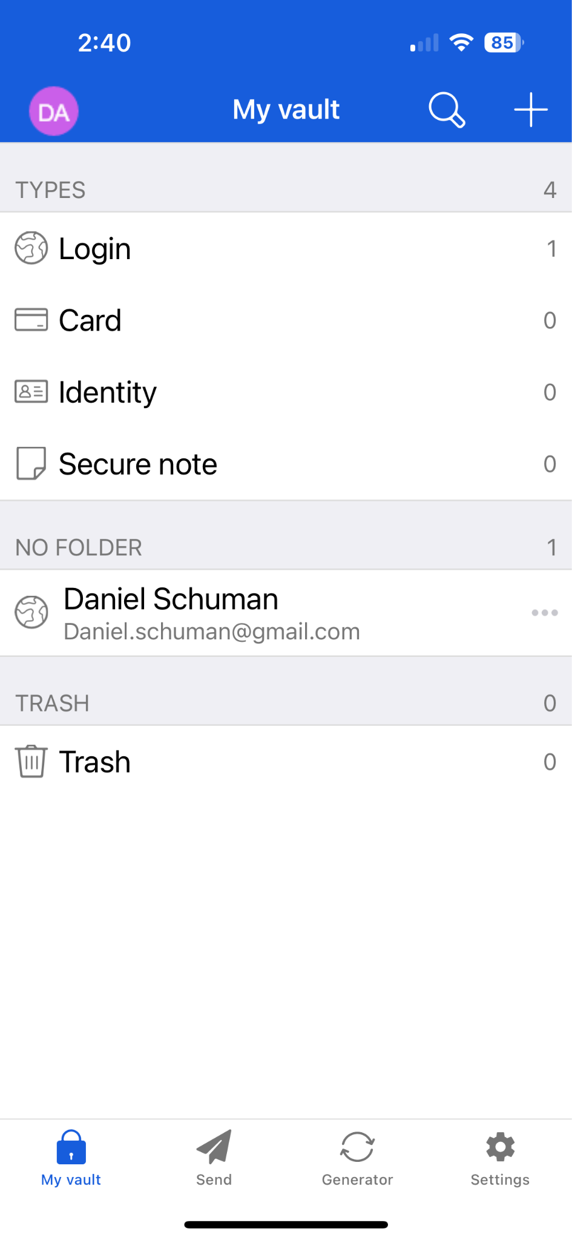
BitWarden
1 primary password
Syncs across all devices (mobile & desktop)
Autofills passwords
$0/month for individual account / $1/month premium/ $3.33/month family account
Notes:
Wirecutter recommends 1Password & BitWarden. Lots of others, but these are good. They solve the problem of remembering all your passwords so you only need to remember one. It can handle 2-factor.

Slide 18
Texting, Mobile, and Email Security
Brandon Pugh
R Street Institute
bpugh@rstreet.org

Slide 19
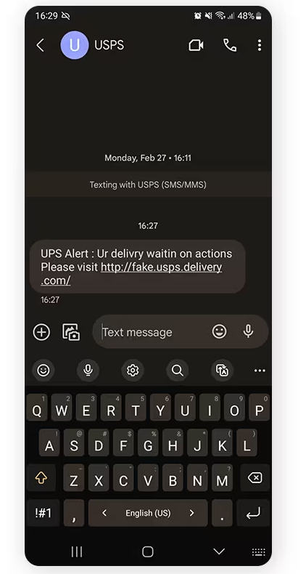
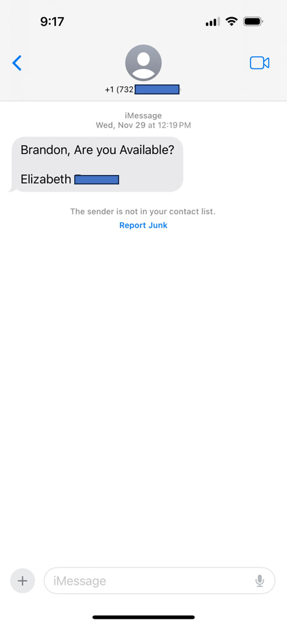

Slide 20
Risks
Spoofing and smishing
  Be cautious of legitimate uses
  Risk even with more secure options
  Be aware of 2FA codes through texts
SMS interception
  Is your intended recipient seeing the text only?
  Lack of authentication, certainty, and encryption
  When is this applicable

Slide 21



Encrypted Communications
Benefits (vary by platform):
  Better sense of recipient
  Ability to create groups
  Disappearing messages
  Desktop versions often available
Various options exist (pros/cons), including:
  Signal
  WhatsApp
Notes:
How many have it installed already?

Slide 22
Other Security Steps
Passcodes with carrier
Avoid shortened links or previews
Consider other 2FA methods
Don’t ignore phone/device updates
Practices specific to iPhone and Android
Various resources online at privacytools.io

Slide 23
Phishing, Spearphishing, and Whaling
Phishing is a form of social engineering where intruders seek to gain access to information and information systems by posing as a real person, business, or organization with legitimate reason to request the information.
Spearphishing is a phishing method that targets specific individuals or groups within an organization.
Whaling is a highly targeted phishing attack - aimed at senior leaders - masquerading as a legitimate email. Whaling is digitally enabled fraud through social engineering, designed to encourage victims to perform an action, such as initiating a wire transfer of funds.

Slide 24
Email Security: Multifactor Authentication
Text-based MFA
Email-based MFA
App-based MFA (e.g., Google, Microsoft, Duo, Okta, LastPass, 1Password, Yubico, RSA)
Biometric
Security key
Question-based MFA
…to be covered by Sean!

Slide 25
Email Security: Links and Attachments
Do you check links and attachments before clicking?
Check links before clicking on them
Only download attachments if you’re sure they’re from the sender
Be cautious of QR codes
Consider Gmail Advanced Protection (ideal for accounts contain particularly valuable files or sensitive information)

Slide 26
Multi-factor Authentication
(aka: MFA, 2-Factor, 2FA, two-step, etc)
Sean Vitka
Demand Progress Education Fund
sean@demandprogress.org

Slide 27
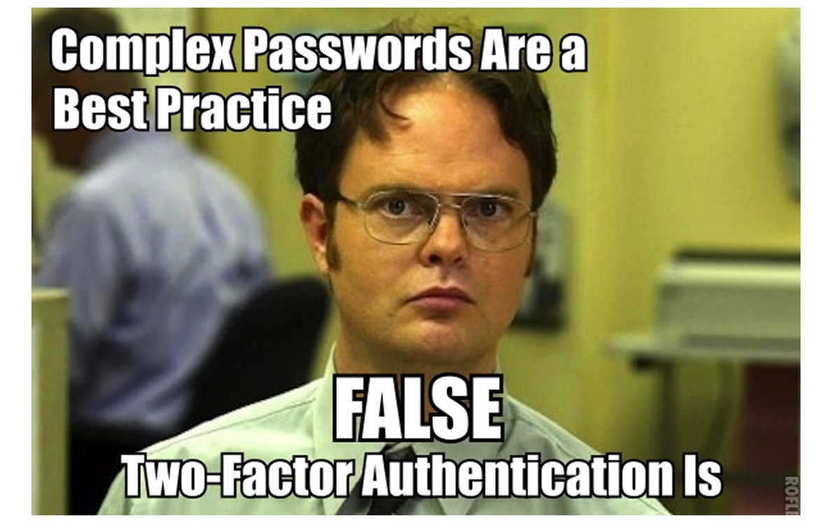

Slide 28
MFA is 1 big thing you can do right now
Enabling MFA/2FA means an online service will require an additional piece of information when a new device tries to log into your account
Generally that extra step is a randomly generated code the provider sends you during login
That code can be sent to your email or phone
The most secure options involve a physical key or an authentication app
Although phone (via a standard SMS text) is the least secure, all DRAMATICALLY increase the security of the account!

Slide 29
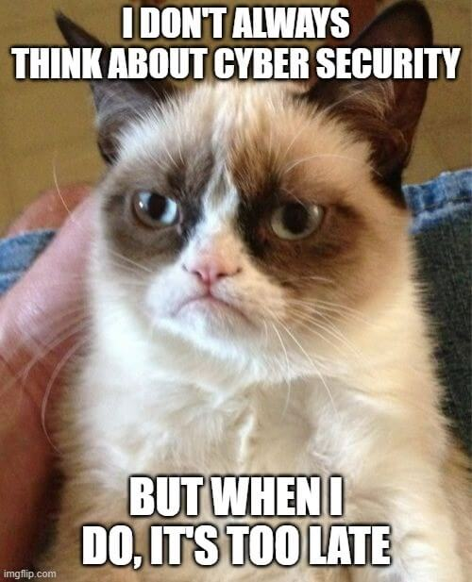
Avoid grumpiness:
SEC on Jan. 9
  Hacked to falsely post Bitcoin ETFs were approved
    Didn’t have 2FA enabled
Colonial Pipeline in 2021
  1 recycled password stolen, MFA/2FA not enabled
Deloitte in 2016-17
  Administrator didn’t have MFA/2FA enabled
Too many more to list!

Slide 30
Why does MFA/2FA work so well?
A bad actor would need access to both your original credentials AND the device receiving the one-time security code
And if someone tries, the one-time code would alert you that your login information (username and password) may be compromised
Specifically responsive to some of the most frequent cybersecurity challenges, like reused and compromised passwords
Authentication app options: Google Authenticator, most password managers (like 1Password)

Slide 31
All trustworthy online services support
All email providers
All banks
Any entity that has your credit card or other financial information
Basically every trustworthy online service
Simply put, if it doesn’t support MFA/2FA, it should not have any of your sensitive information
Each service has its own step-by-step guide once you enable MFA/2FA, generally in security settings
You can also find links to many service’s instructions at https://2fa.directory/us/
  This is crowd-sourced; generally worth going through the service itself

Slide 32
One tiny note…
What if you need to access your MFA/2FA-protected account but lost your phone?
  Best practice (at least for your most important accounts): “backup codes”
  Write them down and put them somewhere safe — just in case lightning strikes twice
  If you have other services sending codes (or PW resets) to a primary email account, that’s the one to do this for

Slide 33
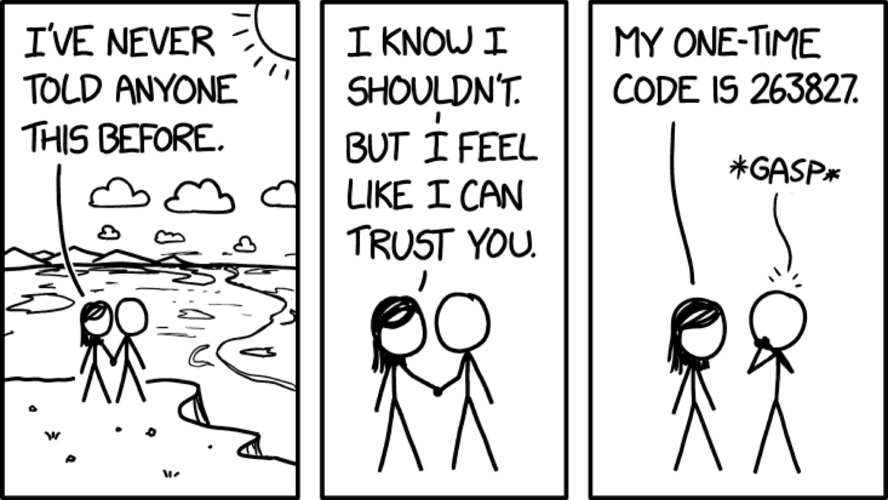

Slide 34
Exit Poll

Slide 35
Q & A

